Slide 1
CNN Image Classifier on FPGA
Che Li & Owen Wang
https://github.com/Owen-yd-Wang/Design-Project.git

Slide 2
Table of Contents
1. Problem Statement
2. Pipeline
3. Modified MobileNetV2
4. Working with Cognichip
5. FPGA Considerations
6. Results
7. Challenges and Lessons Learned
8. Looking Ahead

Slide 3
Problem Statement
Edge AI needs: warehouses, factories, drones need real-time image classification
GPU solutions cost $500-$2000+, draw 200W+, need internet or bulky servers
Small businesses can't justify this cost for simple classification tasks
Solutions:
Design a custom tiny CNN (~48K params) that fits entirely in on-chip BRAM
Quantize to int8 (47 KB) -- only 29% of available BRAM, leaving room for control logic
Verify with behavioral FPGA simulation before writing RTL
/sec, $150 hardware cost, <5W power, no internet needed
Xilnx Artix-7 XC7A35T
225 KB Block RAM (no external DRAM!)
90 DSP48E1 slices (multiply-accumulate units)
20,800 LUTs, 41,600 flip-flops

Slide 4
Pipeline
Reference — our pipeline stages:
1. Train a self designed CNN on CIFAR-10 dataset
2. Export to ONNX
3. Int8 quantization
4. Extract weights to .mem files
5. Behavioral FPGA simulation
6. RTL verification — MAC unit vs Python <- we are here
7. Synthesize on Basys 3 board fpga

Slide 5
Modified MobileNetV2
Why don’t we just use MobileNetV2 ?:
- 3.5M params, 13.3 MB float32 → 15x too large for Basys 3( the board for the project)
- Depth wise separable convolutions need complex control logic
Our modified CNN (~48K params, 47 KB int8):
Conv1: 3→16, 3×3, pad=1 → ReLU → MaxPool2×2 → 16×16×16
Conv2: 16→32, 3×3, pad=1 → ReLU → MaxPool2×2 → 8×8×32
Conv3: 32→32, 3×3, pad=1 → ReLU → MaxPool2×2 → 4×4×32
FC1: 512→64 → ReLU
FC2: 64→10 (10 CIFAR-10 classes)
Conclusion
Total: 47,818 params | Int8 size: ~47 KB | BRAM usage: 29.4%

Slide 6
Working with Cognichip
Cognichip generated the following RTL modules:
- mac_uint8_int32.sv — MAC unit (uint8 × uint8 → uint32)
- line_buffer_3x3.sv — 3-line buffer for sliding window
- depthwise_conv3x3_engine.sv — 3×3 depthwise convolution engine
- pointwise_conv1x1_engine.sv — 1×1 pointwise convolution engine
- inverted_residual_block.sv — MobileNetV2 inverted residual block
Corresponding testbenches:
- tb_mac_uint8_int32.sv
- tb_depthwise_conv3x3_engine.sv
- tb_pointwise_conv1x1_engine.sv
- tb_inverted_residual_block.sv
- tb_complete_inference.sv — full integrated test
- Generated sim.vvp simulation binary (Icarus Verilog)
We used Cognichip to generate functional modules (MAC, line buffer, conv engines, etc.) and numerous testbenches. Individual module tests pass, but the integrated inference test is not yet working — we willdebug and resolve this in the next phase.

Slide 7
FPGA Considerations
Memory (BRAM):
- 225 KB total, no external DRAM
- Weights: 47 KB (Only takes about 30% memory on the board)
- Activations: largest intermediate = 16 KB
- Peak usage: 66.1 KB / 225 KB
Arithmetic:
- MAC unit uses unsigned uint8 - Accumulator is 32-bit to avoid overflow
- Time-multiplexed: one MAC unit shared across all layers

Slide 8
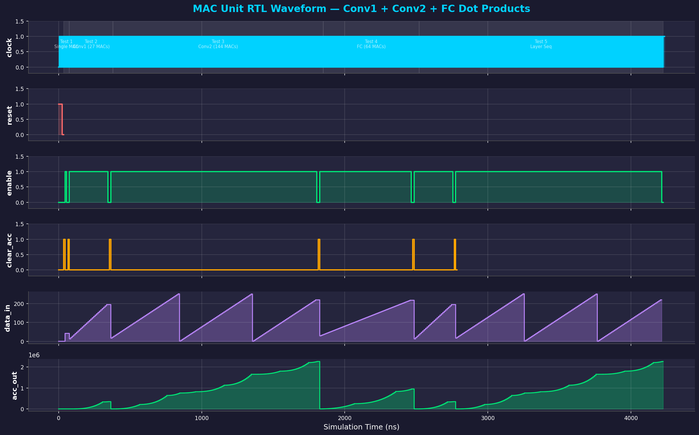
Results
Accuracy (CIFAR-10 test set, 10,000 images):
- Float32: F1 = 0.7400
- Int8: F1 = 0.7395 (delta: -0.0005)
Performance (100 MHz):
- Throughput: 4,008 images/sec
- Latency: 0.25 ms per image
RTL Verification:
- 4/4 tests PASS — bit-exact match with Python

Slide 9
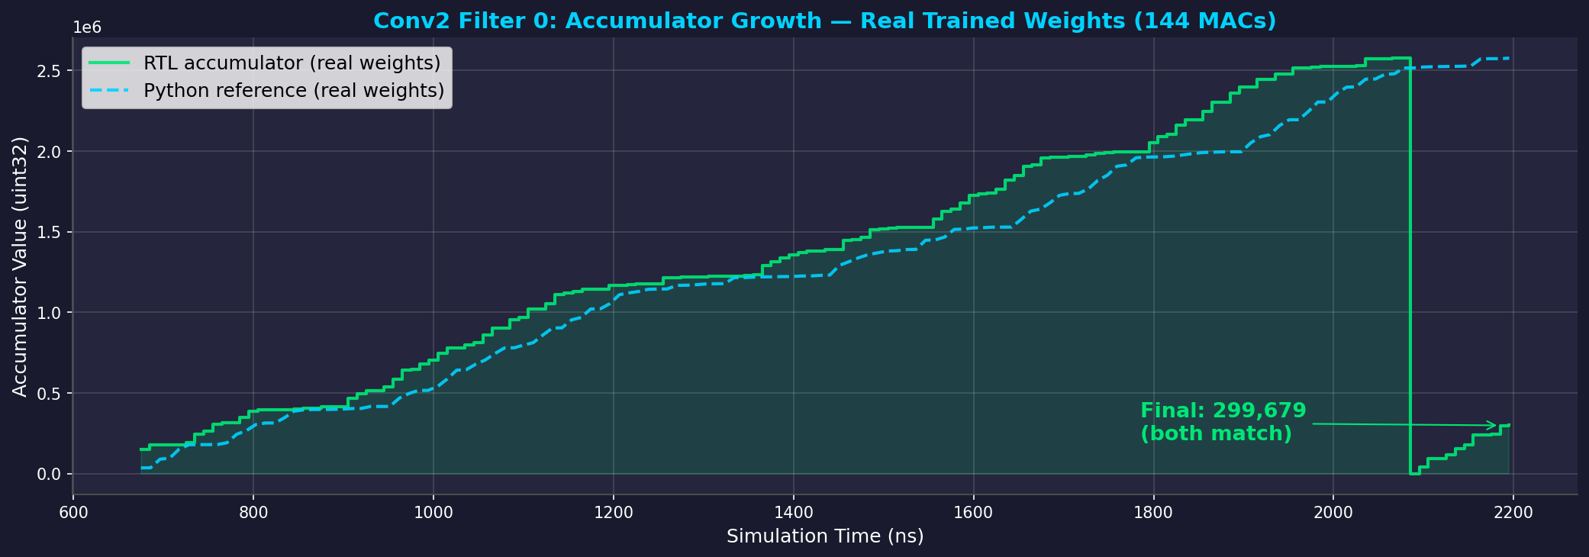

Slide 10
Challenge and Lessons Learned
3.Quantization tooling issues
- ONNX export needed extra dependencies (onnxscript)
- Int8 quantization requires calibration data
1.MobileNetV2 was 15x too large
- Original plan failed immediately
- Had to redesign from scratch for BRAM constraints
2.FC layers dominate weight memory
- FC1 alone: 32K of 48K total parameters (68%)
- Conv layers are surprisingly lightweight

Slide 11
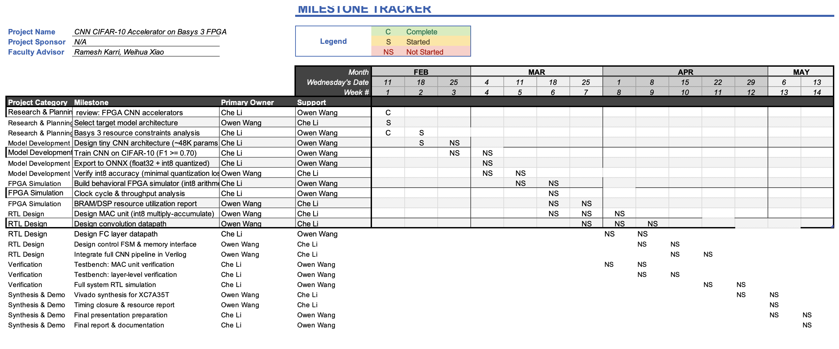

Milestones Tracker

Slide 12
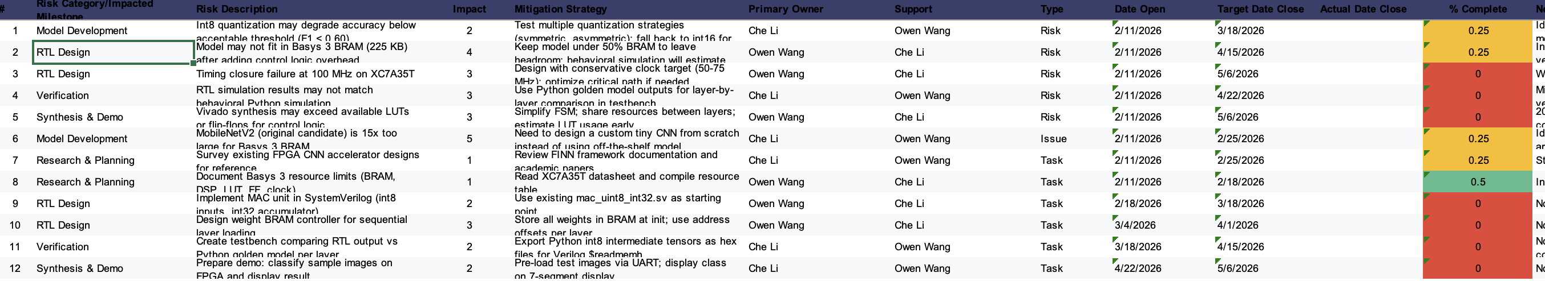
Risks Management

Slide 13
Looking ahead
Next steps:
- Synthesize full CNN
- FPGA board wiring actualize
- Multi-filter parallelism to improve throughput
- Live demo: camera → FPGA → classification result

Slide 14

References
[1] CIFAR-10 Dataset — A. Krizhevsky, "Learning Multiple Layers of Features from Tiny Images," 2009
[2] PyTorch — A. Paszke et al., "PyTorch: An Imperative Style, High-Performance Deep Learning Library," NeurIPS 2019
[3] ONNX Runtime — github.com/microsoft/onnxruntime
[4] Xilinx Artix-7 FPGA Family Data Sheet (DS180)
[5] Basys 3 Reference Manual — Digilent, digilent.com/reference/programmable-logic/basys-3/reference-manual
[6] MobileNetV2 — M. Sandler et al., "MobileNetV2: Inverted Residuals and Linear Bottlenecks," CVPR 2018
[7] FINN Framework — M. Blott et al., "FINN-R: An End-to-End Deep-Learning Framework for Fast Exploration of Quantized Neural Networks," ACM TRETS 2018
[8] Cognichip Co-Design Platform — github.com/Owen-yd-Wang/Design-Project
[9] Icarus Verilog — S. Williams, iverilog.icarus.com
[10] Integer Quantization for Deep Learning Inference — NVIDIA, arXiv:2004.09602, 2020

